Slide 1



Slide 2
 Technical writing is communication written for and about business and industry, focusing on products and services: how to manufacture them, market them, manage them, deliver them, and use them.
 Technical writing is written
in the work colleagues,
environment for supervisors,
subordinates, vendors, and customers.
Technical writing, which must be understood easily and quickly, includes:
memos and e-mail
letters
reports
research proposals
PowerPoint presentations

Slide 3

 “Unclear writing costs American businesses real money—over one billion dollars a year, according to one estimate…
(“Why Dick and Jane Can’t Write on the Job…and How to Help Them,” Janet Van Wicklen, American Society of Training and Development, 2000)

Slide 4

 “The fundamental purpose of scientific
discourse is not the mere presentation of information and thought but rather its actual communication. It does not matter how pleased an author might be to have converted all the right data into sentences and paragraphs; it matters only whether a large majority of the reading audience accurately perceives what the author had in mind.”
George Gopen and Judith Swan The Science of Scientific Writing

Slide 5
Technical writing is not literature; it’s neither prose which recounts the fictional tales of characters nor poetry which expresses deeply felt
Technical writing is neither an expressive essay narrating an
occurrence
Technical writing is not journalism, written to report the news.
Technical writing does not focus on poetic images, describe
personal experiences, or report who won the basketball game.
Instead, technical writing is:
—an instructional manual for repairing machinery
—a memo listing meeting agendas
—a letter from a vendor to a client
—a recommendation report proposing a new computer system

Slide 6
COMPLETENESS
CONCISENESS
CONSIDERATION
CLARITY
CONCRETENESS
COURTESY
CORRECTNESS

Slide 7

Business message is complete when it contains all facts the reader or listener needs for the reaction you desire.
As you strive for completeness, keep the following guidelines in mind;
Provide all necessary information
Answer all questions asked
Give something extra when desirable

Slide 8
Answer all questions that are asked
Give something extra when desirable
Check for five Ws & one H
Who
What
When
Where
Why and
How

Slide 9





Answering the five W’s helps make messages clear: Who, What, When, Where, and Why.
Answer All Questions Asked
Look for questions: some may even appear buried within a paragraph. Locate them and then
answer precisely.
Give Something Extra, When Desirable
Use your good judgment in offering additional material if the sender’s message was
incomplete.

Slide 10

1. Eliminate wordy expressions
Include only relevant statements
be focused
Shorten & avoid long explanations
Avoid unnecessary repetitions
use short forms the second time

Slide 11
Examples
Wordy: Concise:
In about a week’s time… In a week …
Wordy: It is a matter of prime importance…
Concise: It is important…
18

Slide 12




Due to the fact that
Employed the use of
Basic fundamentals
Completely eliminate
Alternative choices
Actual experience
Connected together
Final result
In spite of the fact that
In as few words as possible

Slide 13

Due to the fact that
Employed the use of
Basic fundamentals Completely eliminate
Alternative choices
Actual experience
Connected together
Final result
In spite of the fact that
In as few words as possible
Because
Used
Fundamentals
Eliminate
Alternatives
Experience
Connected
Result
although
Concisely

Slide 14




















Poor: The consultant, who was hired from McKinsey, gave a speech that was long and boring.
Better:

Slide 15




















 We hereby wish to let you know that our company is pleased with the confidence you have respond in us.
 Whenever we achieve a new goal, there is a rise in morale.

Slide 16
CONSIDERATION

Slide 17

Know your audience
Define technical terms when first used Let readers know how you can meet their



needs.
Focus on YOU instead of I & WE
Show reader benefit & interest
Emphasize on positive & pleasant
Apply integrity & ethics

Slide 18
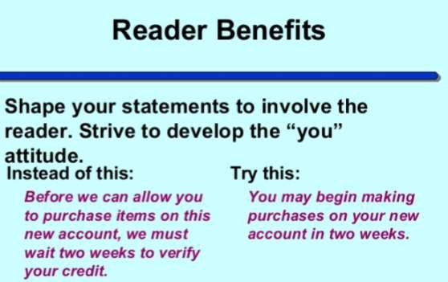

Slide 19
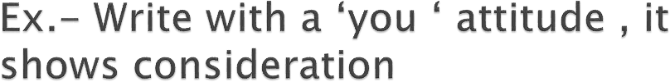
 I want to send my congratulations for –
 (…)

Slide 20
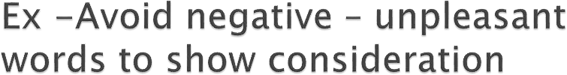
 It is impossible to open an account for you today.
 When you travel on company expense, you will not receive approval for first class fare.

Slide 21

COURTESY

Slide 22

 Involves being aware of the perspective of
others and their feelings.

Slide 23
Suggestions for generating a courteous tone
Be sincere , tactful and appreciative
Avoid using expressions that offend, irritate, or insult others

Slide 24
Be considerate
Avoid being abrupt or blunt, these negative traits are a common cause of discourtesy.
Tactless, Blunt
Considerate, Tactful
It’s my understanding…
According to my understanding
Stupid letter; I can’t understand any of it.

Slide 25

 Avoid being offensive
You failed to Rubbish
Simply nonsense

Slide 26
 Bring courtesy in the following sentence
We don’t feel your qualification match our job needs

Slide 27

Your qualifications are excellent and show that you've assumed greater levels of responsibility throughout your career. The candidate we are looking for, however, will have a stronger marketing background…
 Maintain a positive tone even when breaking bad news.

Slide 28
 Use appropriate language that reflects equal treatment of people regardless of gender, race, ethnic origin, and physical features.

Slide 29
Salesman/lady Sales person
Manpower Workers, Employees
Man-made
Constructed, Manufactured, Built
Chairman Chairperson

Slide 30

If the employee is late, give him one warning.
If the manager files his/her report by Wednesday, he or she will have the revised copy retuned to him or her on Friday.
Don’t judge someone simply on the basis of his gender or color.

Slide 31

CLARITY

Slide 32

Purpose of clarity is to convey your message accurately to reader.
Technical documents should convey a single meaning that the reader can understand.
Unclear writing can lead to wrong interpretation
e.g. unclear instruction on how to operate machinery

Slide 33
 Choose short & familiar words
Construct effective sentences and paragraphs by unity of idea and sequencing
Include examples, illustrations & visual aids

Slide 34
Note:
 Clarity must be from readers’ perspective.
Don’t assume that readers are familiar with previous work or previous reports

Slide 35

Unfamiliar:
After our perusal of pertinent data, the conclusion is that a lucrative market exists for the subject property.
42

Slide 36
Familiar:
The data we studies show that your property is profitable and in high demand.

Slide 37

later agree try replace show
Subsequent
Accede
Endeavour
Supersede
Disclose
44

Slide 38

CONCRETENESS

Slide 39

 Communicating concretely means being specific and to the point instead of being vague and non specific
E.g. Maxwell isn't good at customer service.
Maxwell has the worst customer satisfaction rating in the division at just 58 percent.
(Stated his level of service in terms of the ratings)

Slide 40
It is desirable to be precise and concrete in both written and oral business communication.

Slide 41
Concrete, Precise
Vague, General, Indefinite
 Student GMAT scores are higher.
 In 1996, the GMAT scores averaged 600;
by 1997 they had risen to 610.

Slide 42

CORRECTNESS

Slide 43

 Correctness in technical writing is the use of proper grammar, punctuation, and spelling.
 However a message may be
perfect grammatically and mechanically but still
insult or lose a customer.

Slide 44
 Select the right level of language for your communication either formal or informal.
 In technical and business communication formal language is most often used.
 Check words.
accuracy for figures, facts, and

Slide 45
 Formal and Less Formal Language
More Formal
Less Formal
Participate
Procure Endeavor
Join
Get Try

Slide 46
 http://www.voiceofengineers.com/2013/08/t echnical-writing-for-engineers.html

Slide 47


Technical Report Writing
Importance, Purpose & format

Slide 48

Technical Reports
Discuss the process, progress and results of a technical or scientific research.
Includes in depth experimental details or designs and results.
Typically used in science and engineering fields.

Slide 49
Technical Report and Engineering

Slide 50
communication is the technical report.
 In Engineering, one of the major forms of
Professional Engineers write technical reports to explain project information to various audiences.
At university, reports are read by lecturers in order to assess your mastery of the subjects and your ability to apply your knowledge to a practical task.
In the workplace, they will be read by managers, clients, higher officials and the construction engineers responsible for building from your designs.

Slide 51
Importance of Technical Reports:

Slide 52






WHY do we use technical reports ?
Provide pertinent details of experiments and designs in the field of Engineering and Science.
Sometimes the reports are written to report on a particular research need. For instance, to give particular information that is needed by upper management to make intelligent decisions that will effect a company’s future. In this case the technical report serves as a report of accountability to the organization funding the research.

Slide 53
Purpose:

Slide 54

 The purpose of technical reports is to convey or communicate information in a clear manner.
 Sometimes technical reports aim to persuade the reader, for instance, to persuade the funding organization about the genuineness of your research.

Slide 55


Layout and Format
It is divided into sections which allow different readers to access different levels of information.

Slide 56


Technical Report Layout
Front Cover
Title Page
Abstract
Table of Contents
List of Tables and Figures
Summary Introduction
Methods, Assumptions, and
Procedures
Results and Discussion
Conclusion References
Appendixes List of Symbols, Abbreviations,
and Acronyms
Back Cover

Slide 57

Title page
Abstract
Table of Contents
Introduction
The body of the report (sections with numbered headings)
Conclusions
References
Appendices

